Slide 1










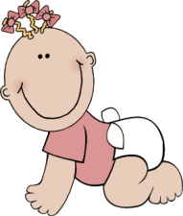
PETER’S FAMILY
LET’S PLAY

Slide 2









grandfather
grandmother
uncle
aunt
father
mother
PETER
sister
brother
cousin
cousins

Slide 3


WHO IS MARK?
FATHER
UNCLE
GRANDFATHER
Mark is Peter’s ______.
NEXT

Slide 4

WHO IS TIM?
BROTHER
COUSIN
FATHER
Tim is Peter’s ______.
NEXT

Slide 5

WHO IS SUSAN?
MOTHER
AUNT
SISTER
Susan is Peter’s _____.
NEXT

Slide 6
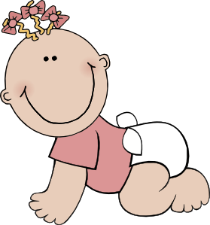

WHO IS SARA?
COUSIN
NIECE
SISTER
Sara is Peter’s _____.
NEXT

Slide 7


WHO ARE PAUL AND PAT?
PARENTS
COUSINS
GRANDPARENTS
Paul and Pat are Peter’s _____.
NEXT

Slide 8

WHO IS MARY?
AUNT
GRANDMOTHER
MOTHER
Mary is Peter’s _______.
NEXT

Slide 9


MATCH
UNCLE
COUSIN
SISTER
NEXT
FATHER

Slide 10
GOOD BYE
GREAT
JOB!
☺
©dorkas

